Slide 1
How can technology be used to enrich math throughout different grade levels?
Does it coincide with the curriculum?
By. Emily, Natasha, Mady, and Jessica

Slide 2
How We Approach Our Inquiry Question
BIG IDEAS
Pros & Cons
Math Resources
lINK2PRACTICE
Looked at the B.C Curriculum
Analyzed the pros and cons of technology
Did our own research to find math games for each grade level
Discussed what resources our Link2Practice teachers use

Slide 3
Why is technology important for math learners?
Using manipulatives and math games can be super beneficial for our learners that require extra visual aid. Technology can make math fun for students by incorporating games.

Slide 4
BIG IDEAS K-7
Kindergarten
Grade 1
-Numbers represent quantities that can be decomposed into smaller parts.
-One-to-one correspondence and a sense of 5 and 10 are essential for fluency with numbers.
-Repeating elements in patterns can be identified.
-Objects have attributes that can be described, measured, and compared.
-Familiar events can be described as likely or unlikely and compared.
- Numbers going up to 20 that can be decomposed smaller, specially 10s and 1s.
- Addition and Subtraction with numbers 10 to develop computational fluency.
- Repeating elements/ patterns can be identified.
- Shapes and objects can be measured, compared, and described.
- Compare graphs, interpret data to show one-to-one correspondence.
Check out this link for the BC Math Curriculum

Slide 5
BIG IDEAS K-7
Grade 4
Grade 7
- Fractions and decimals are type of numbers that can represent quantities
- Development of computational fluency and multiplicative thinking requires analysis of patterns and relations in multiplication and division
- Regular changes in patterns can be identified and represented using tools and tables
- Polygons are closed shaped with similar attributes that can be described, measured, and compared
- Analyzing and interpreting experiments in data probability develops an understanding of chance.
- Use decimals, fractions and percents used to represent whole and partial numbers.
- Computational fluency and flexibility with decimals and integers extending to operations.
- Represent linear relations to identify regularities and make generalizations.
- The constant ratio between circumference and diameter of circles used to describe, measure and compare spatial relationships.
-Illustrate, compare and interpret data from circle graphs.
Check out this link for the BC Math Curriculum

Slide 6
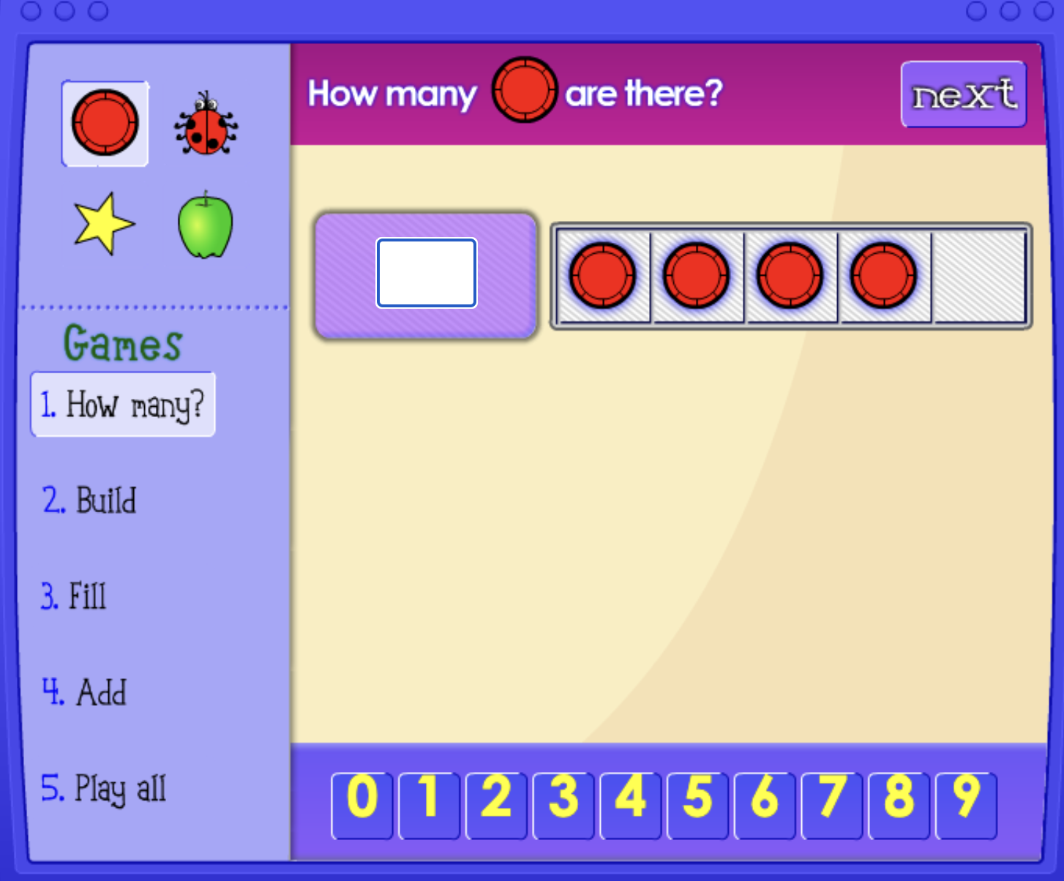
Technologies for….
Kindergarten:
Youtube - Jack Hartmann
Math Games - ABCYA &
NCTM Five Frame
Photos from CoolKindergarten.com https://www.coolkindergarten.com/math/subitizing-adding/

Slide 7
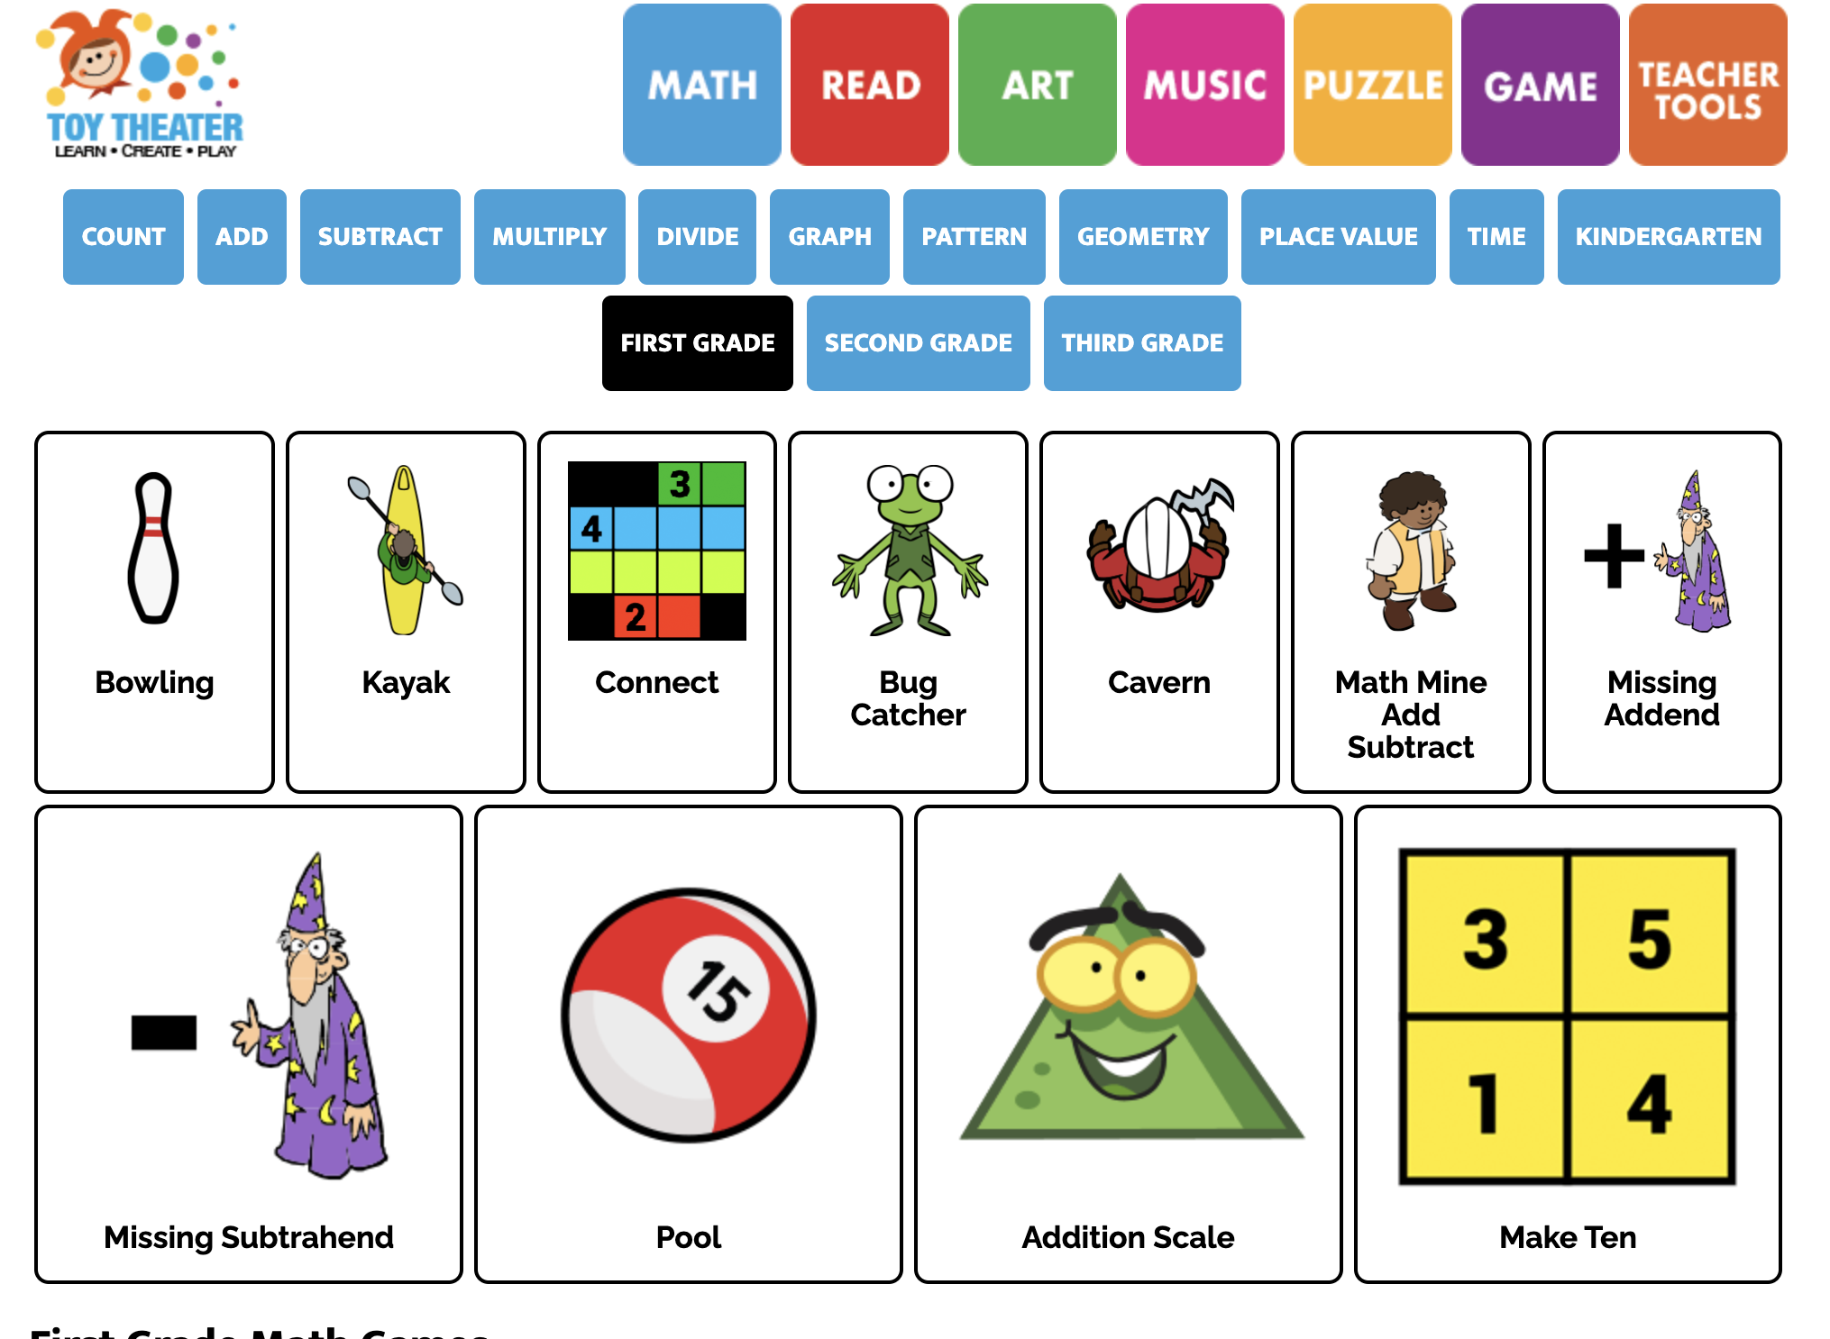
Technologies for….
Grade 1:
Youtube - Move and Groove &
Kids Academy
Math Games - Toy Theater &
Investigations Games
Photo of Toy Theater - Game Options

Slide 8
Technologies for….
Grade 4:
Math Games - Math Playground & Multiplication.com
Printable Worksheets - Education.com
Picture from Math Playground

Slide 9
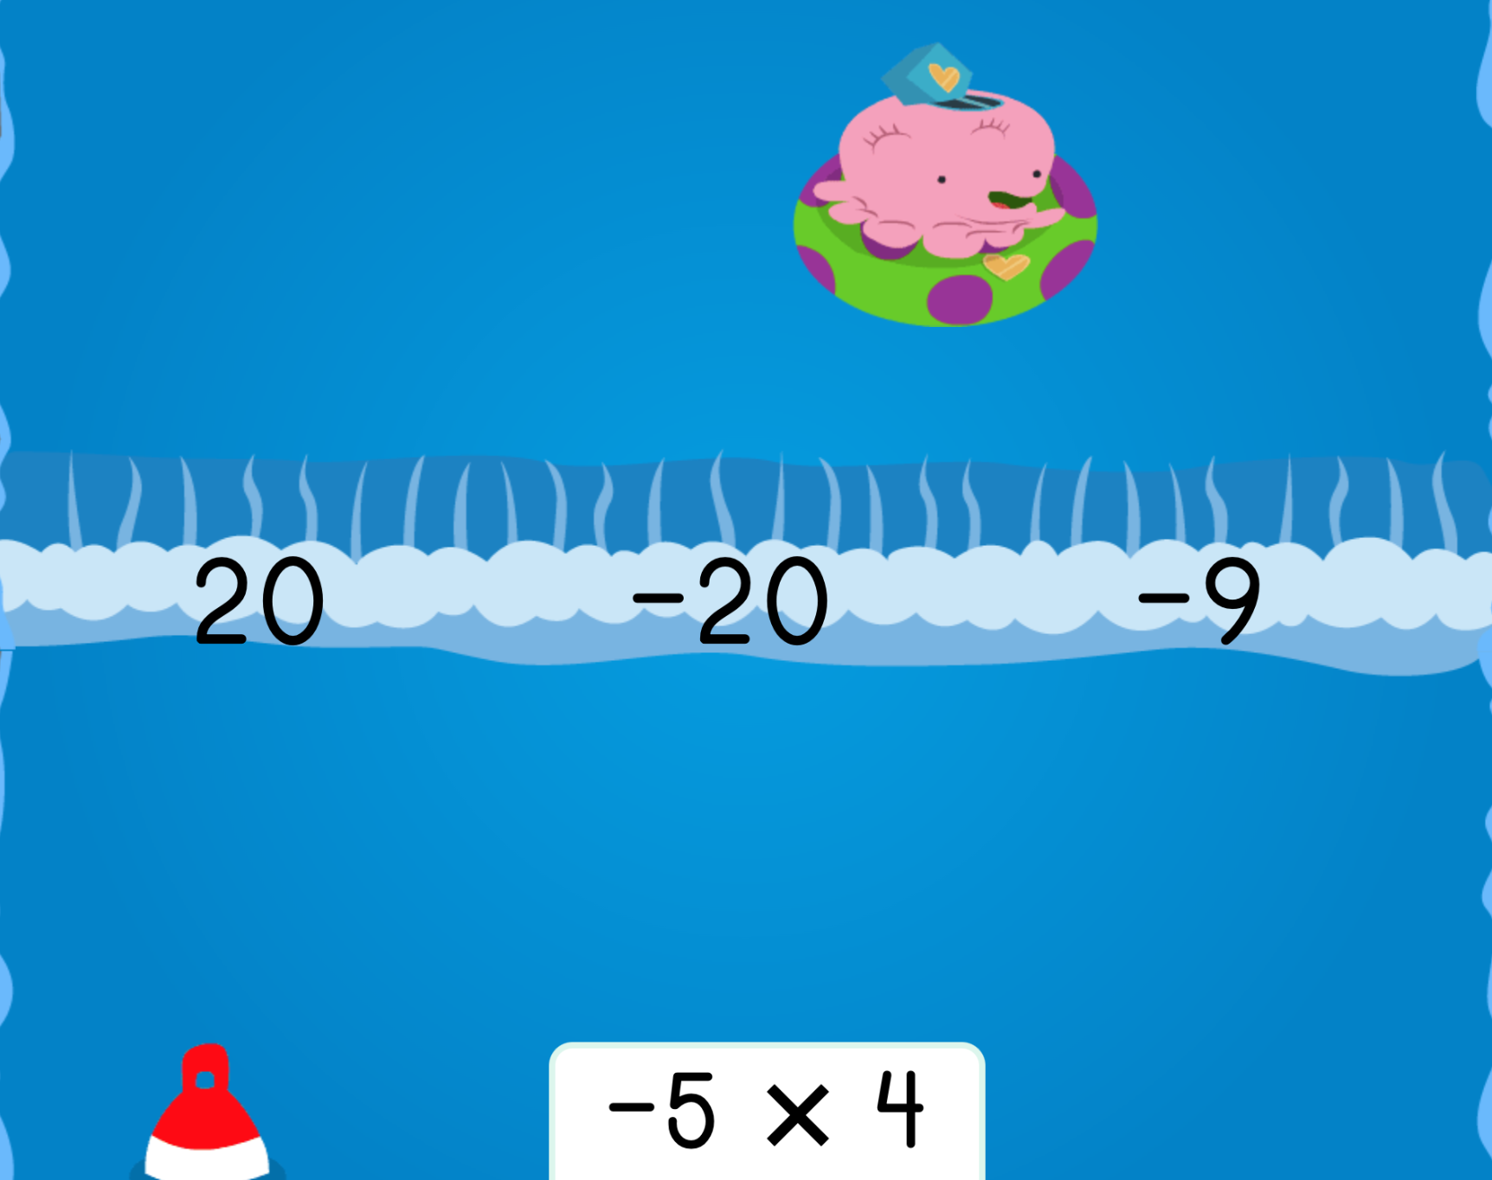
Technologies for….
Grade 7
Math Games - Adapted Mind & Education.com
Further Practice - IXL
Photo of Water Rafting: Multiplying Integers from Education.com

Slide 10
But what issues may arise when using technology
In the classroom ?
01
02
03
04
Parent concerns
Distracting for students
Promotes high amounts of screen time
Inappropriate use of online tools

Slide 11
How we can address these concerns
Parent concerns:
Get parents involved. Send students home with a link so their parents get to try and see how the game works. Allows parents to use and see benefits of online learning tools.
Distraction:
Setting strict technology times. Set specific, non-negotiable, boundaries for students on when where how to use technologies.
Screen time:
Provide even balance. Focus on implementing a mixture of online and hands on learning. Allow for flexibility depending on the day/week.
Inappropriate usage:
Set a no tolerance rule for inappropriate use of tech. A 1 strike rule - if caught once technology privileges are revoked, up to teacher discretion if tech time can be granted back or not.

Slide 12
Benefits For Using technology In Math
01
02
03
04
Reinforce learning through games
Different use of manipulatives such as online counters
Can be suitable for all learners
Youtube videos can help reinforce concepts

Slide 13
How we will implement these resources

Slide 14
What tech in our class will look like
Designated tech time
Integrated at beginning of the year
Promote low-stress learning
For example, Students can use tech during free time blocks. For math specifically, online math games can only be done once assignments are completed.
To make kids more accustomed to the idea of technology, ensure it is casually introduced at the start of the year. This way students know what to expect.
Instead of assigning homework, provide kids with a link to try at home. Many students struggle with math so providing learning games creates a low stress learning environment

Slide 15
THANKS!

